Slide 1

Bank Loan Default Prediction
Group 18
Srivats Narain
Aishwarya Sadagopan
Madathil Geetanjali Menon
Gunakshi Sharma
Sai Sravanthi Varanasi
Varsha Sharma
06.12.2022.
1

Slide 2
Agenda
Complication
Situation
We have bank dataset with loan payment status as dependant variable.
→ Data had irregularities like: Blank values, N/A, outliers
The banks have a challenging problem to predict if a customer will default on loan payment with limited information
Question
Answer
Models applied:
LogisticRegression
Decision Tree
KNN
To build predictive ML models to assess if a customer will default on the loan
1

Slide 3
Project Steps
01
02
03
04
Obtain data
EDA
Data Cleaning
Model
Obtain data from Kaggle data set
Perform Exploratory data analysis using visualization to better understand the data
Identify and remove or correct inaccurate records from the dataset
Building predictive model and checking the accuracy
1

Slide 4
Exploratory Data Analysis
2

Slide 5
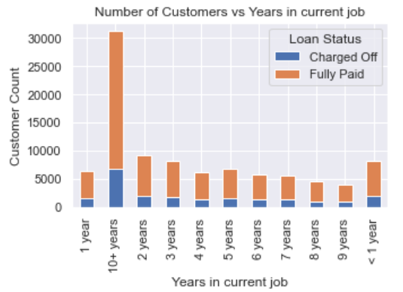
Data Analysis
Distribution of customers: Charged Off vs Fully Paid
Equal proportion of customer distribution across parameter
2

Slide 6
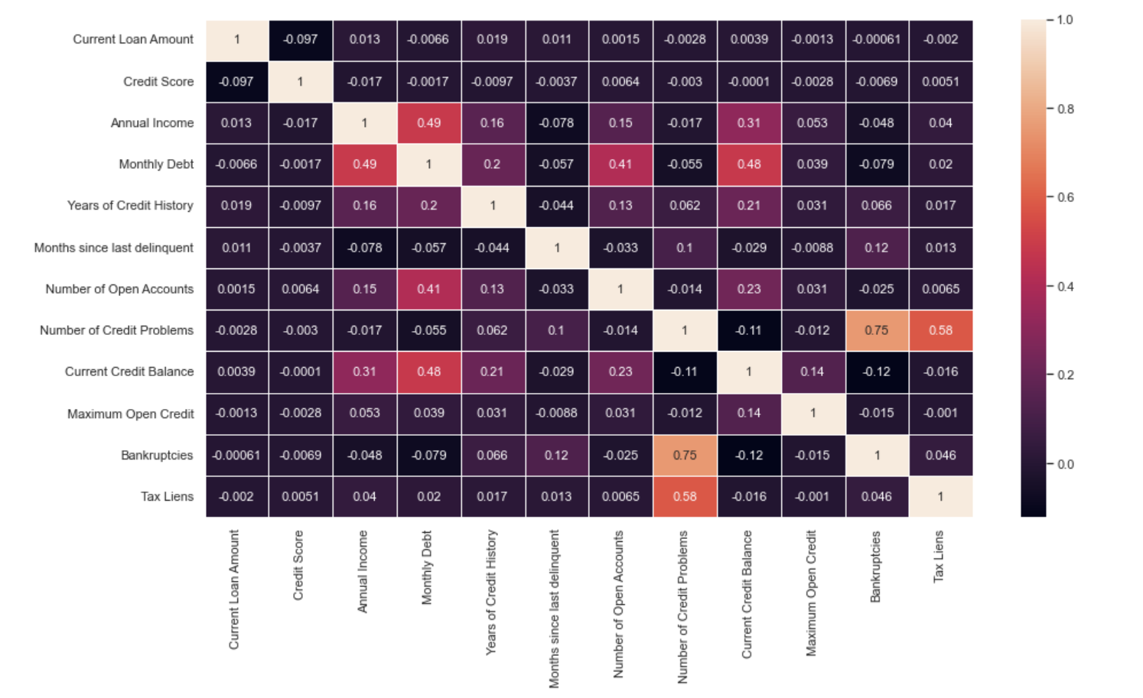
Data Analysis
Correlation Heatmap of columns in the dataset
2

Slide 7
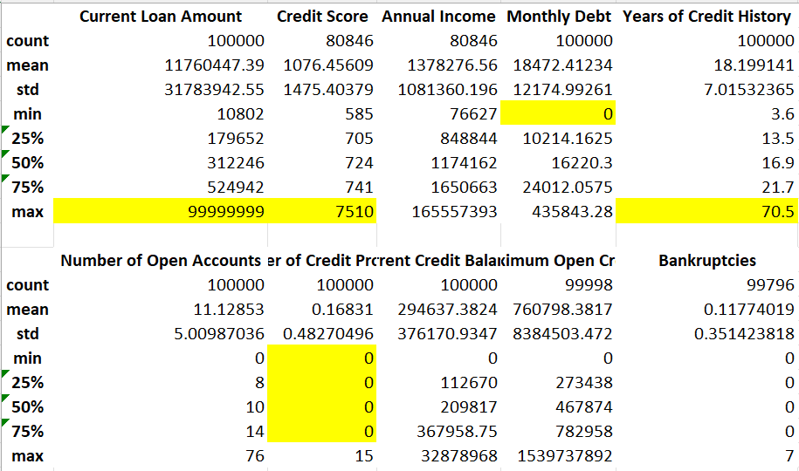
Data Analysis
Summary Statistics
Mentioned data was used for feature engineering
3

Slide 8
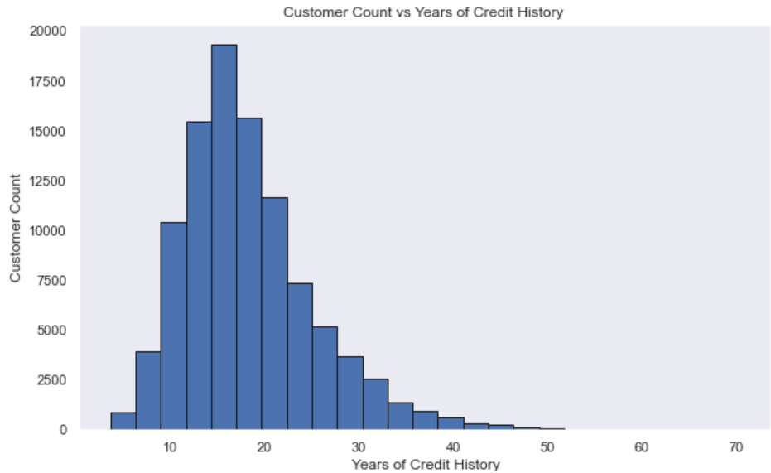

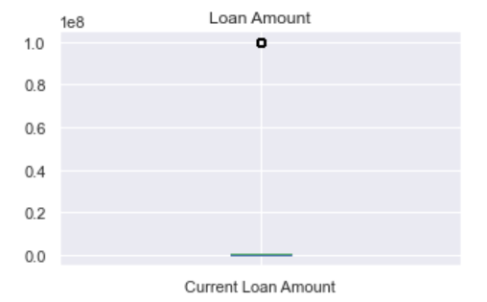
Data Analysis
Mapping and removal of outliers in data
Graph is normally distributed with outliers greater than 50 years of credit history
Distribution of customers vs years in current job
Distribution of Current Loan Amount
There is an outlier of 99 Million
3

Slide 9
Data Cleaning
4

Slide 10
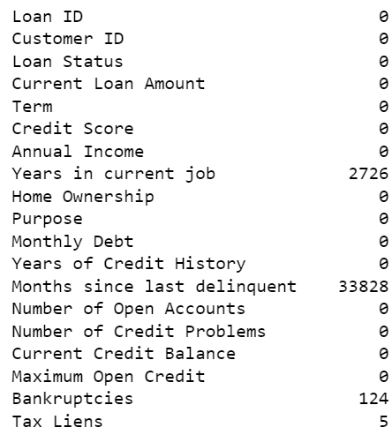
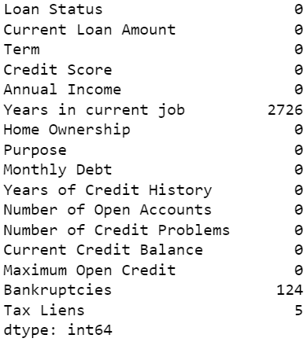
Data Cleaning
Before Cleaning
After Cleaning
Removing redundant columns
The columns - Loan ID and column ID are irrelevant for the model
The column ‘Months since last delinquent’ has high null values. Replacing them will impact the correlation coefficient hence we are dropping the column
Replacing categorical variables
Coded categorical variables into numerical values
4

Slide 11
Data Imbalance
4

Slide 12
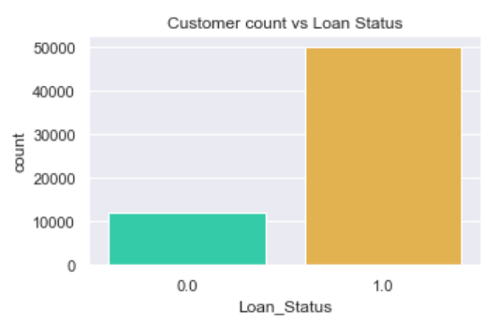
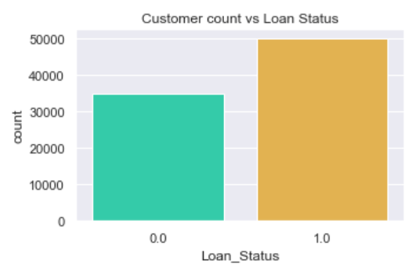
Data Imbalance
Before Resampling
After Resampling
Loan Status vs Customer Count
Decision Variable ‘Loan Status’ has majority of data inclined towards ‘Fully Paid’ category
This would result in overfitting of data
To resolve this issue , we performed data resampling
4

Slide 13

Model
Logistic Regression
Decision Tree
KNN
Decision Tree
5

Slide 14
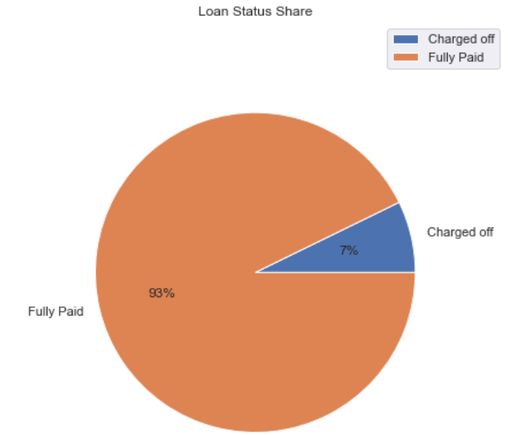
Logistic Regression
Logistic regression is used to describe data and explain relationship with one dependent binary variable and one or more independent variables
Based on the logistic regression model we are trying to fit our financial model of predicting the target variable – Loan Status
Model Accuracy : 78.02%
5

Slide 15
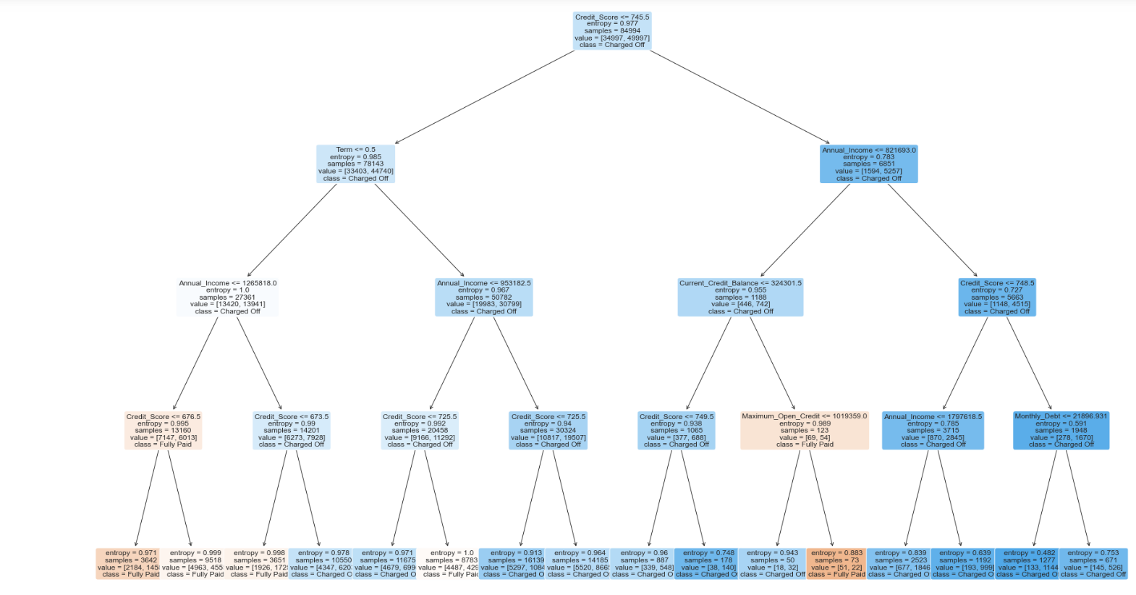
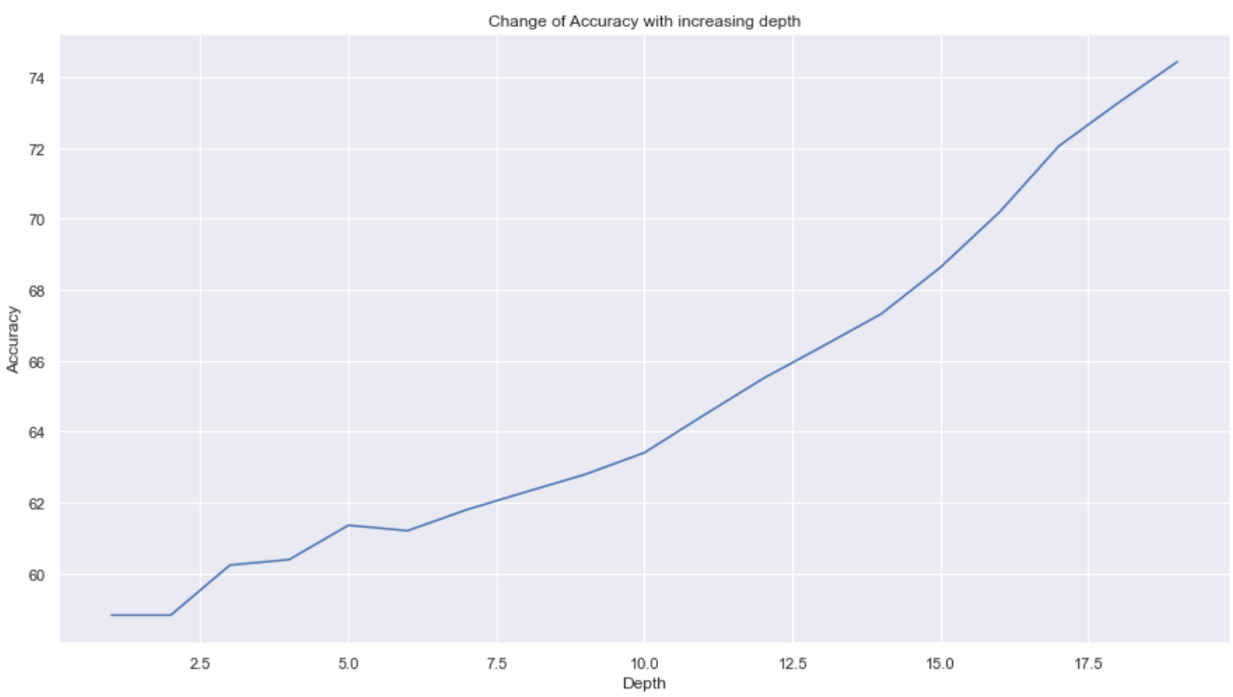
Decision Tree
Used to develop a training model that may be used to forecast the category or value of the target variable by learning straightforward decision rules extrapolated from historical data (training data)
Our model's accuracy tends to increase as max_depth is increased
Model Accuracy : 76.79%
6

Slide 16
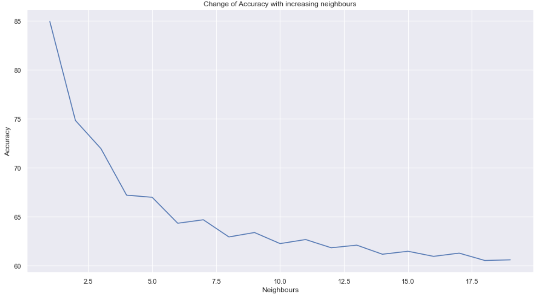
KNN
The model predicts the elements based on k neighbors value and distance calculation method
The model's accuracy tends to decrease with increase in the model parameter – neighbors
Model Accuracy : 64.19%
6

Slide 17
Post Modeling Analysis
6

Slide 18
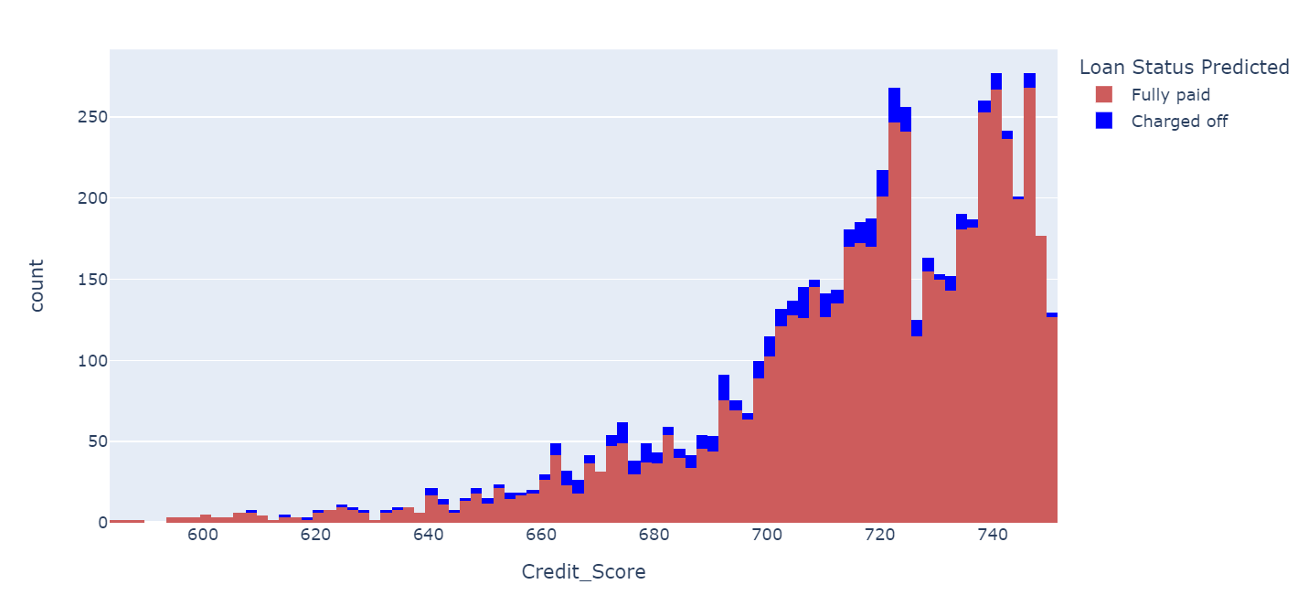
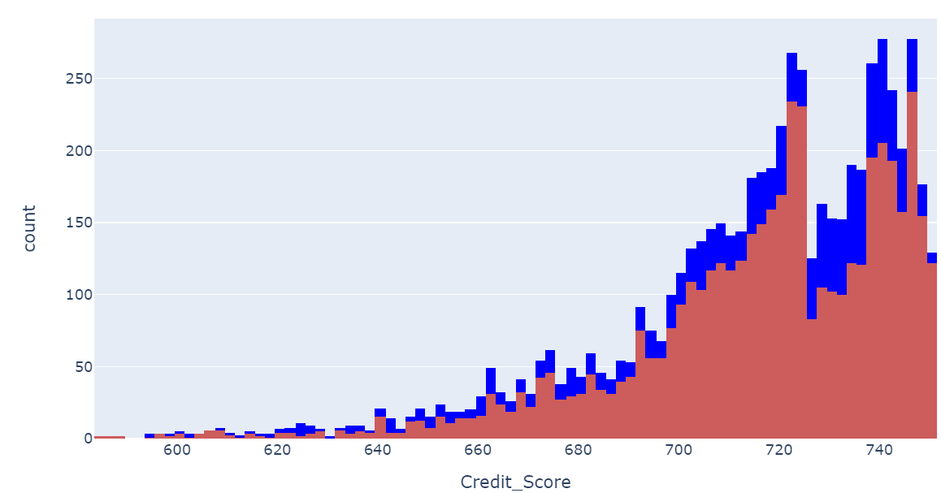
Customer Loan Distribution by credit score
Logistic Regression Output
Decision Tree Output
We can observe that people categorized as “Fully Paid” and “Charged Off” are in the credit score range of [640,740]
To avoid any further financial risks for the company we need to scrutinize the loan sanctions from this credit range
6

Slide 19
Thanks !

